Slide 1
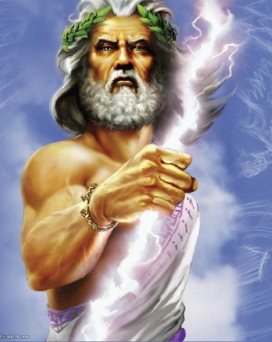
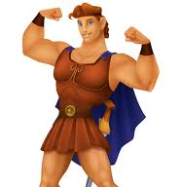
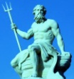
facebook
Wall
Photos
Zeus
Logout
Zeus is thinking about a party on earth tonight! Anyone else coming?
Wall
Info
Photos
Write something…
Share
View photos
Hera
Zeus! Your status better be a joke! Not funny!
Send a message
Poke
Zeus
I’m the king! What are you going to do about it?
Friends
Hera
Do you really want to find out?
Hera
Demeter
Cupid
Zeus
Change of plans… staying home tonight! Really need to stop posting party plans…
Aphrodite
Hercules
Poseidon
Demeter
Zeus, I really want to talk to you about Persephone. I don't see why our daughter has to live six months of the year in that dungeon of an underworld.
Zeus
I told you, I've done all I can do to convince Hades to free her. If you ask me, the fact that I was able to convince him to release her for part of the year was a BIG deal.
Cupid
Uncle Z, thanks so much for helping me and Psyche get married. My mom was being a bit psycho.
Aphrodite
Dislike!
Zeus
My pleasure, Cupid. Psyche's a looker. I always try to keep Olympus stocked with beautiful women. Aphrodite, your beauty is unmatchable.
Aphrodite
;-)

Slide 2
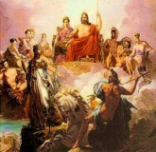
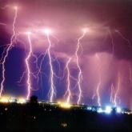
facebook
Wall
Photos
Zeus
Logout
Wall
Info
Photos
Basic Information
Name | Zeus
Nickname | Jupiter, Jove
Sex | Make
Birthday | I don’t like to think about it because my father tried to eat me (true story).
Current City | Mount Olympus
View photos
Send a message
Poke
Photos
Work and Education
2 Albums
Occupation | King of the gods, lord of the sky, god of weather, enforcer of the law and justice
Education | I was born knowing everything
The Family
Updated last Tuesday
Relationships
Mobile Uploads
Updated two months ago
Relationship Status | Married to my sister Hera. It’s really complicated. In relationships with Io, Leda, Europa, Danae…
Parents | Cronus (dad), Rhea (mom)
Siblings | Hestia, Demeter, Hades, Poseidon, Hera
Children | Apollo, Artemis, Ares, Aphrodite (maybe), Athena, Dionysus, Hebe, Hephaestus (maybe), Hermes, the Muses, Pan, Persephone, Helen, Heracles (a.k.a. Hercules), Minos, Orion, Perseus, and so many more … (see relationship status)
Enemies | My dad, the titans, Typhon, Echidna
Interests
Likes | The sky, lightening bolts, oak trees, eagles
Activities | Throwing lightening at people, punishing my enemies, disguising myself as animals to seduce innocent young maidens
Quotations | "It's a man's world." – James Brown "If you must break the law, do it to seize power: in all other cases observe it." – Julius Caesar
Music | Lightning Strikes by Aerosmith, Stairway to Heaven by Led Zeppelin, Jupiter from The Planets by Holst, Thunderstruck by AC/DC
Movies | I Think I Love My Wife, The Godfather, Clash of the Titans

Slide 3
facebook
Wall
Photos
Logout
Wall
Info
Photos
Basic Information
Name
Nickname
Sex
Birthday
Current City
View photos
Send a message
Poke
Photos
Work and Education
2 Albums
Occupation
Education
Updated last Tuesday
Relationships
Updated two months ago
Relationship Status
Parents
Siblings
Children
Enemies
Interests
Likes
Activities
Quotations
Music
Movies

Slide 4
facebook
Wall
Photos
Logout
Wall
Info
Photos
Write something…
Share
View photos
Send a message
Poke
Friends
.
.

